Slide 1
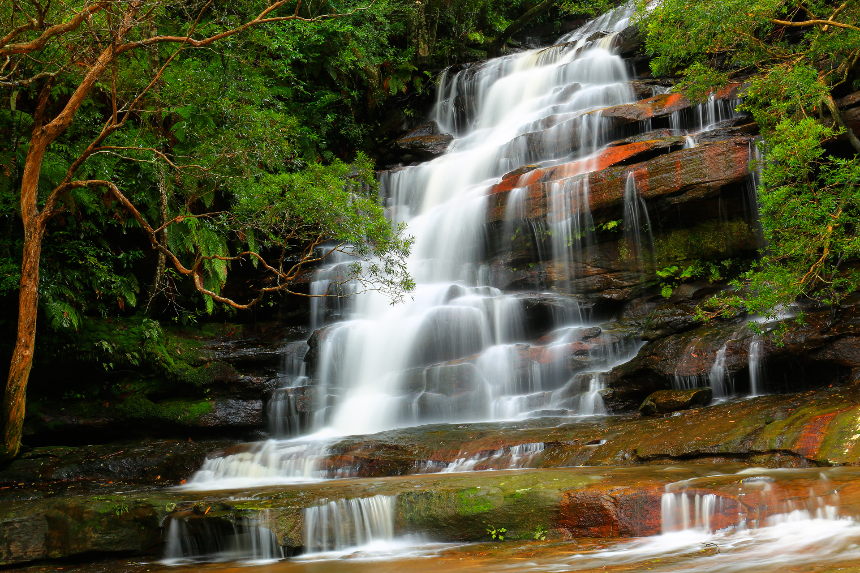
Control Flow
Notes:
[0:30;0-1]
Hello guys and welcome.
Today, we focus on commands that allow us control the flow of our program.

Slide 2

Anyone who saw Karel in a dream last night?

Slide 3
move
You know I just know how to
turn left
put beeper
pick beeper
I am ashamed to say I cannot turn right

Slide 4
No worries, we can define it for you
def turn_right():
turn_left()
turn_left()
turn_left()
def turn_right():
for i in range(3):
turn_left()

Slide 5
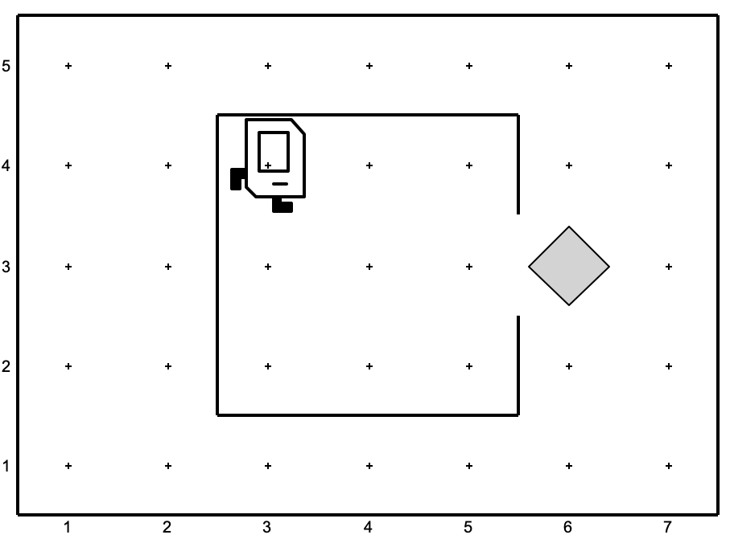
You taught Karel how to pick newspapers, did she do it this morning?
def turn_right():
for i in range(3):
turn_left()
def move_to_newspaper():
move()
move()
turn_right()
move()
turn_left()
move()
…
def main():
move_to_newspaper()
pick_beeper()
move_to_start()
if __name__ == "__main__":
run_karel_program()
Notes:
[2:0; 8-10]
call Karel’s commands
define our own commands
indentation
calling our command means…
readable

Slide 6
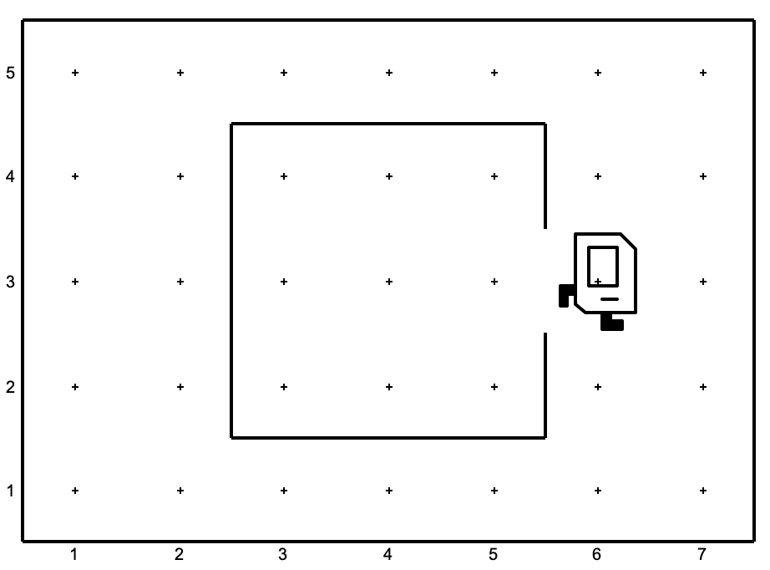
You taught Karel how to pick newspapers, did she do it this morning?
…
def turn_around():
for i in range(2):
turn_left()
def move_to_start():
turn_around()
for i in range(3):
move()
turn_right()
move()
turn_right()
def main():
move_to_newspaper()
pick_beeper()
move_to_start()
if __name__ == "__main__":
run_karel_program()
Notes:
[2:0; 8-10]
call Karel’s commands
define our own commands
indentation
calling our command means…
readable

Slide 7
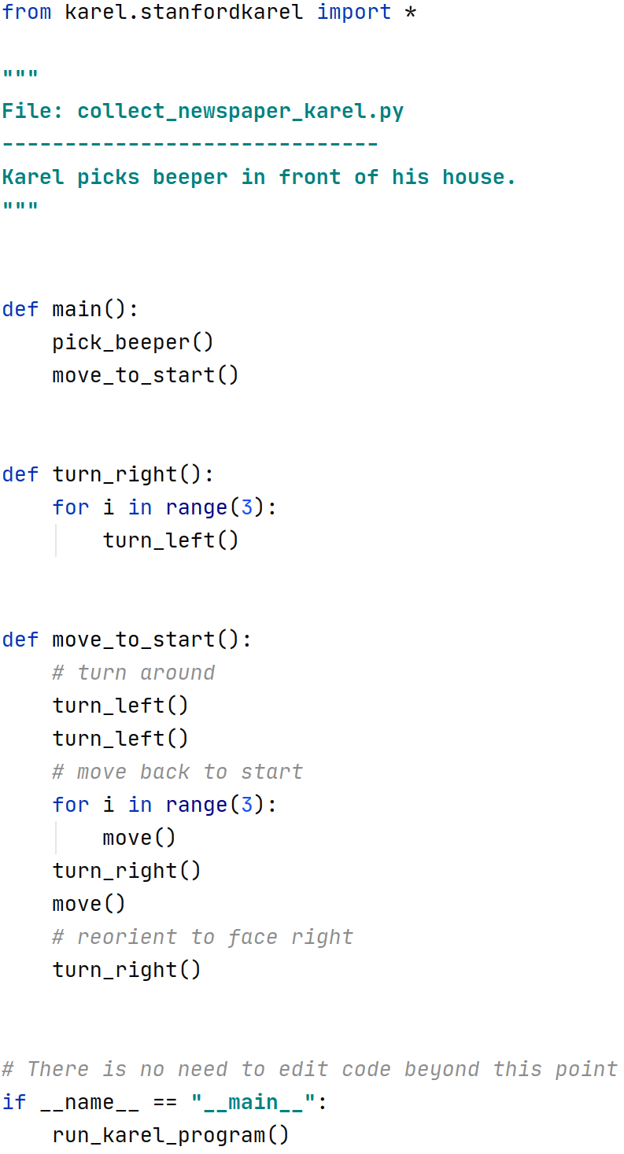
Multi-line comment
Main function
Our function
Single-line comment
Notes:
[2:30 11-14]
main function
other functions own commands
comments
first and few last lines

Slide 8
As long as Karel knows the world, its size, where the beepers are, she can do anything.
What if she does not know where the walls and beepers are?
Notes:
[2:0; 8-10]
call Karel’s commands
define our own commands
indentation
calling our command means…
readable

Slide 9
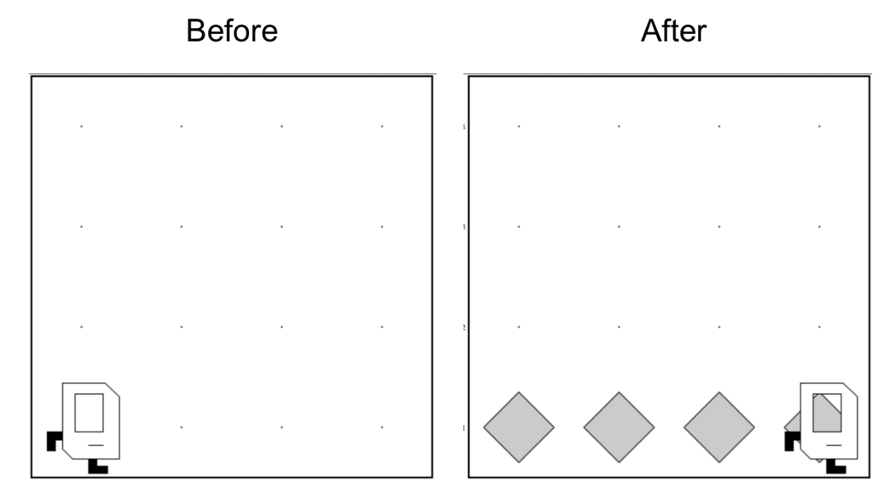
Fill a street with beepers in a world of any size.
?
Notes:
[1:0 14-15]
unknown dimensions
beeper line

Slide 10
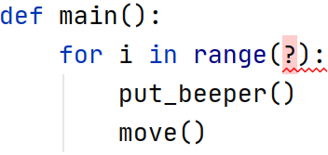
?
We have an alternative for the for loop
Notes:
[1:0; 15-16]
hit wall
leave empty corner
need to ask, condition

Slide 11
Karel can check a few things about the world
Test | Opposite | What it checks
front_is_clear() | front_is_blocked() | Is there a wall in front of Karel?
left_is_clear() | left_is_blocked() | Is there a wall to Karel’s left?
right_is_clear() | right_is_blocked() | Is there a wall to Karel’s right?
beepers_present() | no_beepers_present() | Are there beepers on this corner?
beepers_in_bag() | no_beepers_in_bag() | Any there beepers in Karel’s bag?
facing_north() | not_facing_north() | Is Karel facing north?
facing_east() | not_facing_east() | Is Karel facing east?
facing_south() | not_facing_south() | Is Karel facing south?
facing_west() | not_facing_west() | Is Karel facing west?
Maybe we can ask her to move as long as front is clear
Notes:
[1:0; 16-17]
we can ask these
simple questions with YES/NO answer

Slide 12
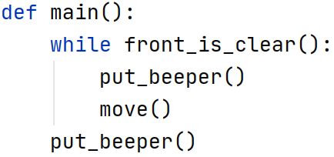
condition
body
indentation
command outside body
Notes:
[1:45; 17-19]
Meet the while loop.
evaluate a condition
YES/NO answer
is front clear?
YES: execute body and evaluate again
NO: skip body
indentation
it reads...

Slide 13
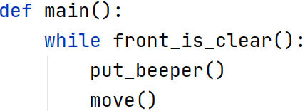
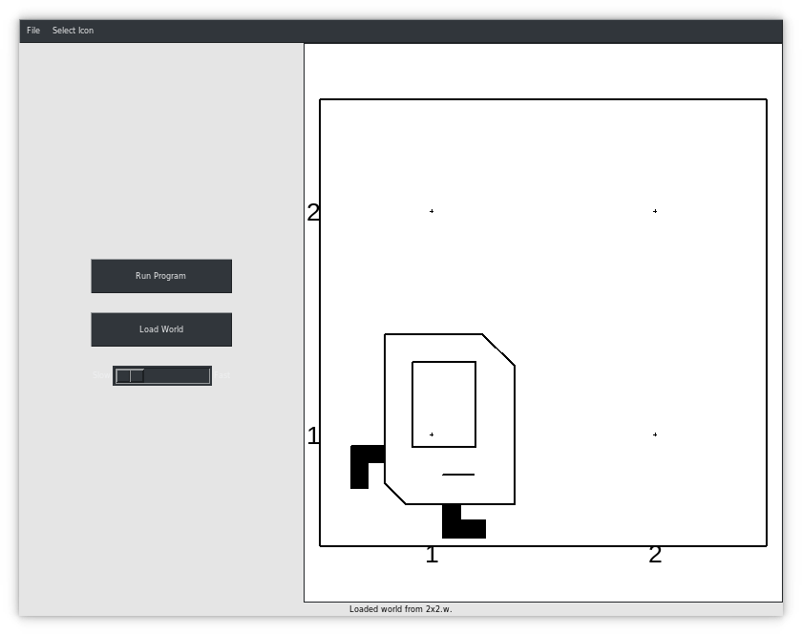
Notes:
[0:45 19-20]
trace the program
it is not correct, wait

Slide 14
Notes:
[0:45; 20-21]

Slide 15
YES
Notes:
[0:45; 20-21]

Slide 16
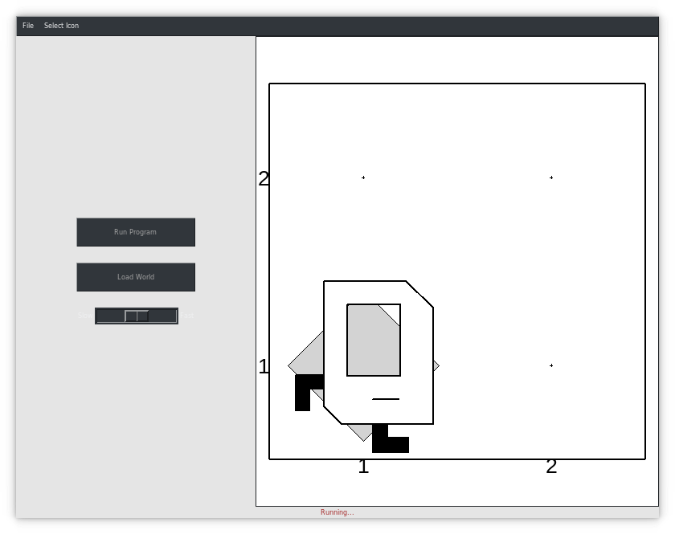
Notes:
[0:45; 20-21]

Slide 17
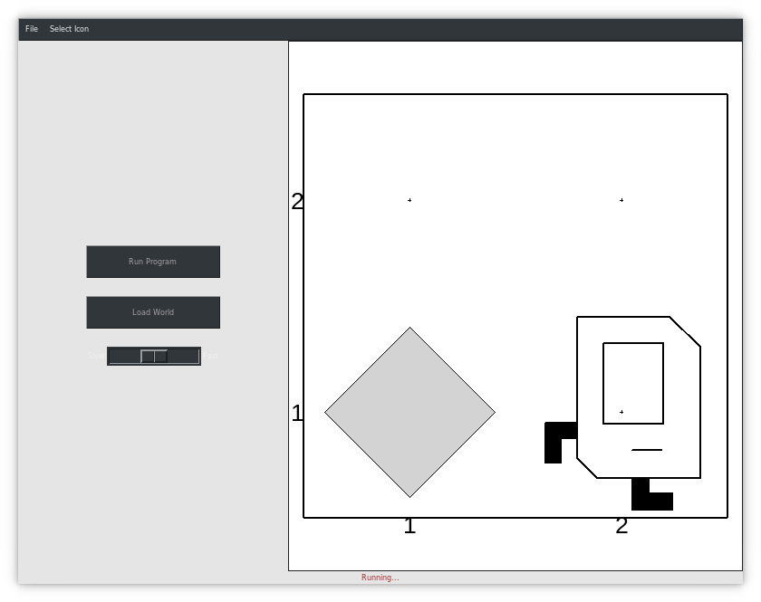
Notes:
[0:45; 20-21]

Slide 18
NO
Notes:
[0:45; 20-21]

Slide 19
What if we run the loop once more?
Notes:
[0:45; 20-21]
The program ended like this.
not correct
NEXT

Slide 20

Notes:
[0:30 21-22]
bug
missing beeper

Slide 21
N beepers
N−1 moves
Notes:
[1: 22-23]
do: N beepers, N moves, N=1
need: N beepers, N-1 moves, N=2

Slide 22


Fencepost
I want Karel to put down a row of beepers until it reaches a wall. How do I do this?
put_beeper()
move()
put_beeper()
move()
put_beeper()
move()
put_beeper()
We must put 4 beepers but move 3 times!

Slide 23
Fencepost
I want Karel to put down a row of beepers until it reaches a wall. How do I do this?
We must put 4 beepers but move 3 times!
while front_is_clear():
put_beeper()
move()
put_beeper()

Slide 24
Fencepost
I want Karel to put down a row of beepers until it reaches a wall. How do I do this?
while front_is_clear():
put_beeper()
move()
put_beeper()

Slide 25
Fencepost
I want Karel to put down a row of beepers until it reaches a wall. How do I do this?
while front_is_clear():
put_beeper()
move()
put_beeper()

Slide 26
Fencepost
I want Karel to put down a row of beepers until it reaches a wall. How do I do this?
while front_is_clear():
put_beeper()
move()
put_beeper()

Slide 27
Fencepost
I want Karel to put down a row of beepers until it reaches a wall. How do I do this?
while front_is_clear():
put_beeper()
move()
put_beeper()

Slide 28
Fencepost
I want Karel to put down a row of beepers until it reaches a wall. How do I do this?
while front_is_clear():
put_beeper()
move()
put_beeper()

Slide 29
Fencepost
I want Karel to put down a row of beepers until it reaches a wall. How do I do this?
while front_is_clear():
put_beeper()
move()
put_beeper()

Slide 30
Fencepost
I want Karel to put down a row of beepers until it reaches a wall. How do I do this?
while front_is_clear():
put_beeper()
move()
put_beeper()

Slide 31
Fencepost
I want Karel to put down a row of beepers until it reaches a wall. How do I do this?
while front_is_clear():
put_beeper()
move()
put_beeper()

Slide 32
Fencepost
I want Karel to put down a row of beepers until it reaches a wall. How do I do this?
while front_is_clear():
put_beeper()
move()
put_beeper()

Slide 33
Fencepost
I want Karel to put down a row of beepers until it reaches a wall. How do I do this?
while front_is_clear():
put_beeper()
move()
put_beeper()

Slide 34
Fencepost
I want Karel to put down a row of beepers until it reaches a wall. How do I do this?
while front_is_clear():
put_beeper()
move()
put_beeper()

Slide 35
Fencepost
I want Karel to put down a row of beepers until it reaches a wall. How do I do this?
while front_is_clear():
put_beeper()
move()
put_beeper()

Slide 36
Fencepost
I want Karel to put down a row of beepers until it reaches a wall. How do I do this?
while front_is_clear():
put_beeper()
move()
put_beeper()

Slide 37
Fencepost
I want Karel to put down a row of beepers until it reaches a wall. How do I do this?
put_beeper()
move()
put_beeper()
move()
...
put_beeper()
We must put N beepers but move N-1 times!

Slide 38
Fencepost
I want Karel to put down a row of beepers until it reaches a wall. How do I do this?
put_beeper()
move()
put_beeper()
move()
put_beeper()
move()
put_beeper()
Any suggestion for an alternative? A different way to group and loop

Slide 39
Fencepost
I want Karel to put down a row of beepers until it reaches a wall. How do I do this?
put_beeper()
move()
put_beeper()
move()
put_beeper()
move()
put_beeper()

Slide 40
Fencepost
I want Karel to put down a row of beepers until it reaches a wall. How do I do this?
put_beeper()
while front_is_clear():
move()
put_beeper()

Slide 41
Fencepost
I want Karel to put down a row of beepers until it reaches a wall. How do I do this?
put_beeper()
move()
put_beeper()
move()
put_beeper()
...
move()
put_beeper()
We must put N beepers but move N-1 times!

Slide 42
Loops Overview
I want Karel to repeat some commands!
Know how many times
Don’t know how many times
for loop
while loop
Notes:
E.g. “pick up all the beepers on this square”
E.g. “turn until you’re facing west”
E.g. “put down 5 beepers”

Slide 43
Fencepost Structure
The fencepost structure is useful when you want to loop a set of statements but do one part of that set 1 additional time.
put_beeper() # post
while front_is_clear():
move() # fence
put_beeper() # post
# or...
while front_is_clear():
put_beeper() # post
move() # fence
put_beeper() # post

Slide 44
Champion’s dance
def main():
while front_is_clear():
move()
turn_left()

Slide 45
Reminder!
Karel is very picky about indentation.
Make sure to indent a code block 1 level further when you:
Define a new Karel command
Write a for loop
Write a while loop
You may nest these. Make sure you keep track of your indentation!

Slide 46
Projects for today: Place Square

Slide 47
Projects for today: Mountain Karel

Slide 48
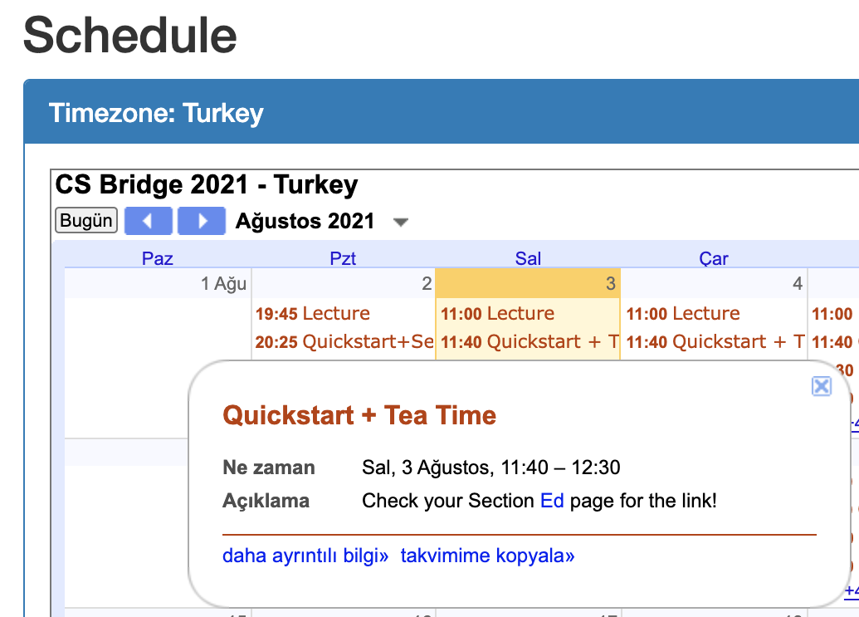
No panic, first days may be a bit chaotic.

